Slide 1
24ADI003-MACHINE LEARNING

Slide 2
Course Objectives:
The purpose of taking this course is to:
Introduce the fundamental concepts of machine learning, its life cycle and ethical considerations.
Explore various supervised and unsupervised learning techniques and optimization strategies.
Examine recommendation systems, and its evaluation techniques.

Slide 3
Course Outcomes
After successful completion of this course, the students shall be able to
CO1 Apply appropriate data pre-processing techniques to build machine learning models with ethical considerations. (Ap)
CO2 Analyze and optimize regression models using estimation techniques, regularization, and gradient-based methods through error analysis. (An)
CO3 Build and evaluate the effectiveness of different classification models and ensemble techniques. (E)
CO4 Analyze complex datasets using advanced clustering, associative rule mining and dimensionality reduction algorithms to uncover meaningful patterns and groupings. (An)
CO5 Develop recommendation systems to personalize user needs. (Ap)

Slide 4
Course Content
INTRODUCTION
Introduction to Machine Learning-Types of machine learning: Supervised, Unsupervised, Semi supervised and Reinforcement Learning-Applications of machine learning in various fields- Ethics in machine learning- Fairness, accountability and interpretability -Machine learning workflow- Data Preprocessing-Feature engineering- Correlation analysis- Model training and evaluation- Model monitoring and maintenance.
REGRESSION MODELS
Linear regression- Simple Regression-Least Square Estimator-Maximum Likelihood Estimator– Multiple Regression –Polynomial Regression-Performance Metrices-Bias
CLASSIFICATION MODELS
Logistic Regression-Naive Bayes Classifiers-Decision Tree-K-Nearest Neighbors-Support Vector Machine – Evaluation metrices – AUC ROC- Class Imbalance –SMOTE – Cross-Validation Techniques-Ensemble Learning-Bagging- Random Forests-Boosting - AdaBoost -Gradient Boosting
UNSUPERVISED LEARNING
Clustering- K-means Clustering- Gaussian Mixture Models -Hierarchical Clustering- Density-Based Clustering (DBSCAN)- Mean-Shift Clustering- Spectral Clustering- Association Rule Learning- Apriori Algorithm- FP-Growth Algorithm- Dimensionality Reduction- Principal Component Analysis (PCA)- Linear Discriminant Analysis (LDA)
RECOMMENDATION SYTEMS
Introduction to Recommendation Systems-Types- Challenges- Collaborative Filtering Techniques- User-Based-Collaborative Filtering- Item-Based- Collaborative Filtering- Matrix Factorization Techniques- Content-Based Recommendation- Hybrid Recommendation Systems- Evaluation of Recommendation Systems

Slide 5
Unit III – CLASSIFICATION MODELS
Logistic Regression-Naive Bayes Classifiers-Decision Tree-K-Nearest Neighbors-Support Vector Machine – Evaluation metrices – AUC ROC- Class Imbalance –SMOTE – Cross-Validation Techniques-Ensemble Learning-Bagging- Random Forests-Boosting - AdaBoost -Gradient Boosting

Slide 6
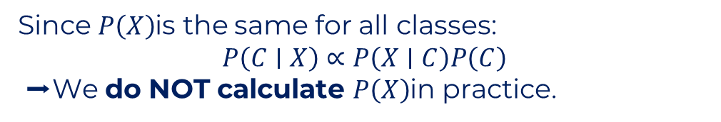
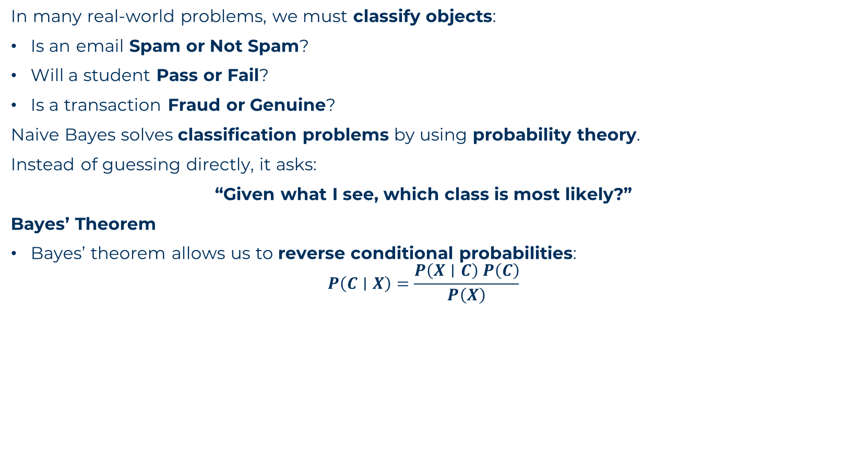
NAIVE BAYES CLASSIFIER
In many real-world problems, we must classify objects:
Is an email Spam or Not Spam?
Will a student Pass or Fail?
Is a transaction Fraud or Genuine?
Naive Bayes solves classification problems by using probability theory.
Instead of guessing directly, it asks:
“Given what I see, which class is most likely?”
Bayes’ Theorem
Bayes’ theorem allows us to reverse conditional probabilities:
$$P\left(C∣X\right)=\frac{P\left(X∣C\right) P\left(C\right)}{P\left(X\right)}$$
Term | Meaning
(P(C)) | Prior probability (how frequent the class is)
(P(X)) | Evidence (same for all classes)
Since $P\left(X\right)$is the same for all classes:
$$P\left(C∣X\right)∝P\left(X∣C\right)P\left(C\right)$$
➡ We do NOT calculate $P\left(X\right)$in practice.

Slide 7
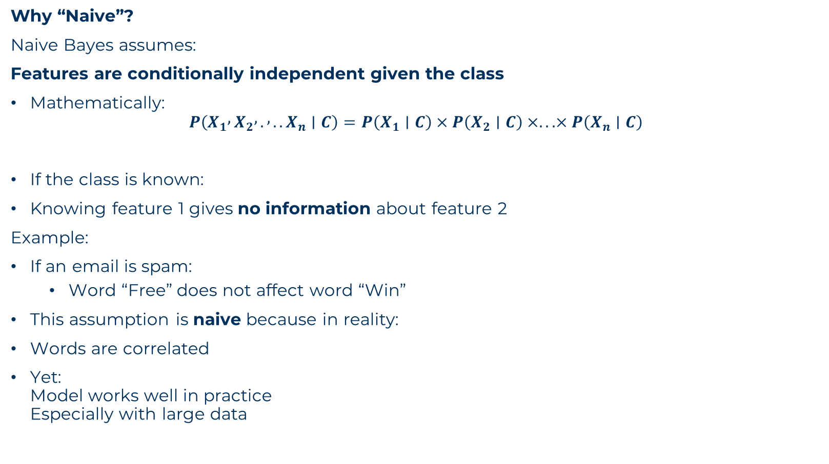
NAIVE BAYES CLASSIFIER
Why “Naive”?
Naive Bayes assumes:
Features are conditionally independent given the class
Mathematically:
$$P\left(X_{1} , X_{2} , . , ..X_{n}∣C\right)=P\left(X_{1}∣C\right)×P\left(X_{2}∣C\right)×...×P\left(X_{n}∣C\right)$$
If the class is known:
Knowing feature 1 gives no information about feature 2
Example:
If an email is spam:
Word “Free” does not affect word “Win”
This assumption is naive because in reality:
Words are correlated
Yet: Model works well in practice Especially with large data

Slide 8
NAIVE BAYES CLASSIFIER
Example (Spam Classification)
Email contains:
“Free Win Offer”
Naive Bayes treats it as:
P(Free,Win,Offer∣Spam)=P(Free∣Spam)P(Win∣Spam)P(Offer∣Spam)

Slide 9
NAIVE BAYES CLASSIFIER
Types of Naive Bayes
1 Gaussian Naive Bayes
Used when:
Features are continuous
Assumes normal distribution
Example:
Height
Marks
Temperature
2 Multinomial Naive Bayes
Used when:
Features are counts
Example:
Word frequency in documents
3 Bernoulli Naive Bayes
Used when:
Features are binary (0/1)
Example:
Word present or absent

Slide 10
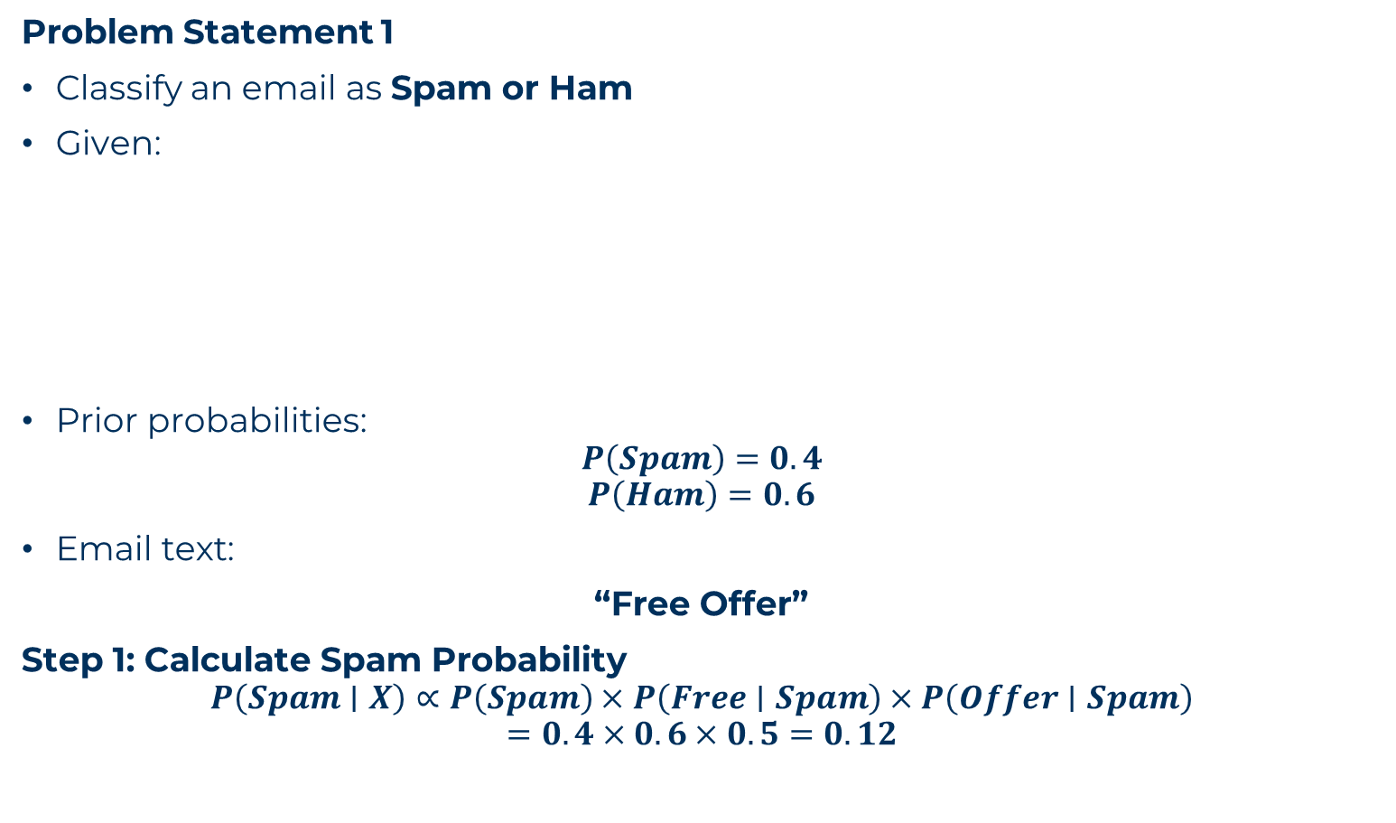
NAIVE BAYES CLASSIFIER
Problem Statement 1
Classify an email as Spam or Ham
Given:
Prior probabilities:
$$P\left(Spam\right)=0.4$$
$$P\left(Ham\right)=0.6$$
Email text:
“Free Offer”
Step 1: Calculate Spam Probability
$$P\left(Spam∣X\right)∝P\left(Spam\right)×P\left(Free∣Spam\right)×P\left(Offer∣Spam\right)$$
$$=0.4×0.6×0.5=0.12$$
Word | P(Word | Spam) | P(Word | Ham)
Free | 0.6 | 0.1
Offer | 0.5 | 0.2

Slide 11
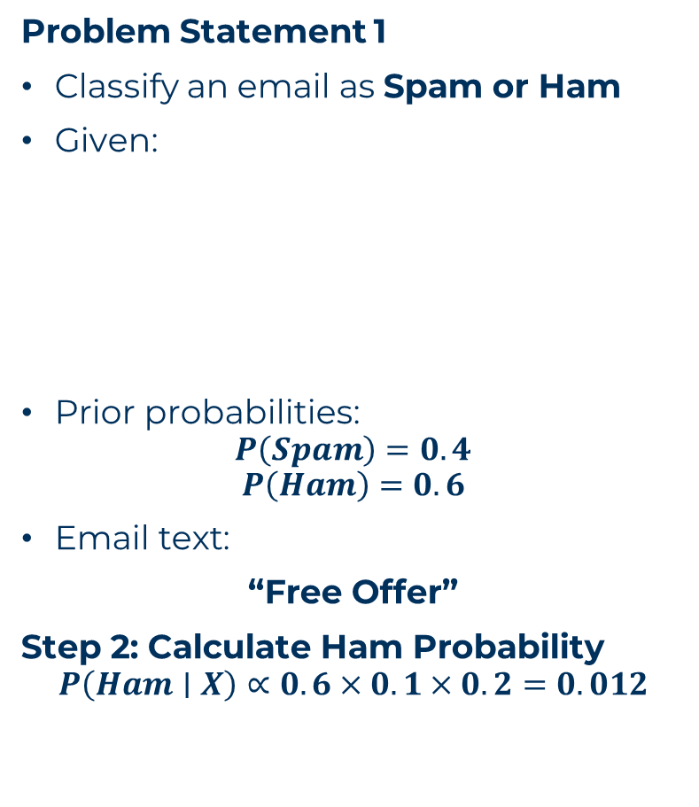
NAIVE BAYES CLASSIFIER
Problem Statement 1
Classify an email as Spam or Ham
Given:
Prior probabilities:
$$P\left(Spam\right)=0.4$$
$$P\left(Ham\right)=0.6$$
Email text:
“Free Offer”
Step 2: Calculate Ham Probability
$$P\left(Ham∣X\right)∝0.6×0.1×0.2=0.012$$
Word | P(Word | Spam) | P(Word | Ham)
Free | 0.6 | 0.1
Offer | 0.5 | 0.2
Step 3: Compare Scores
Class | Score
Spam | 0.12
Ham | 0.012
Prediction: Spam

Slide 12
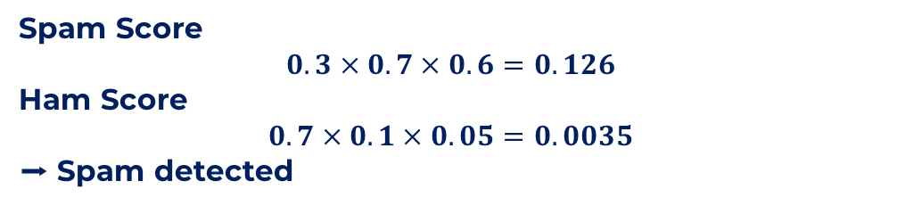

NAIVE BAYES CLASSIFIER
Problem Statement 2
Given Data
Priors:
$$P\left(Spam\right)=0.3$$
$$P\left(Ham\right)=0.7$$
Email:
“Free Win”
Word | P(Word | Spam) | P(Word | Ham)
Free | 0.7 | 0.1
Win | 0.6 | 0.05
Hello | 0.1 | 0.6
Spam Score
$$0.3×0.7×0.6=0.126$$
Ham Score
$$0.7×0.1×0.05=0.0035$$
➡ Spam detected

Slide 13
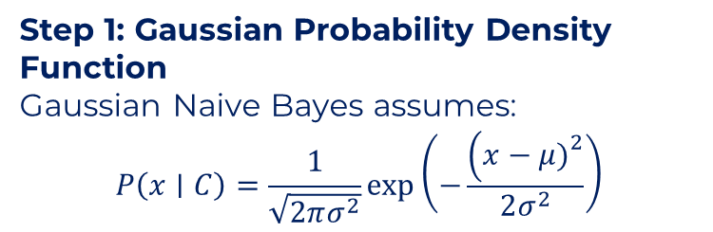
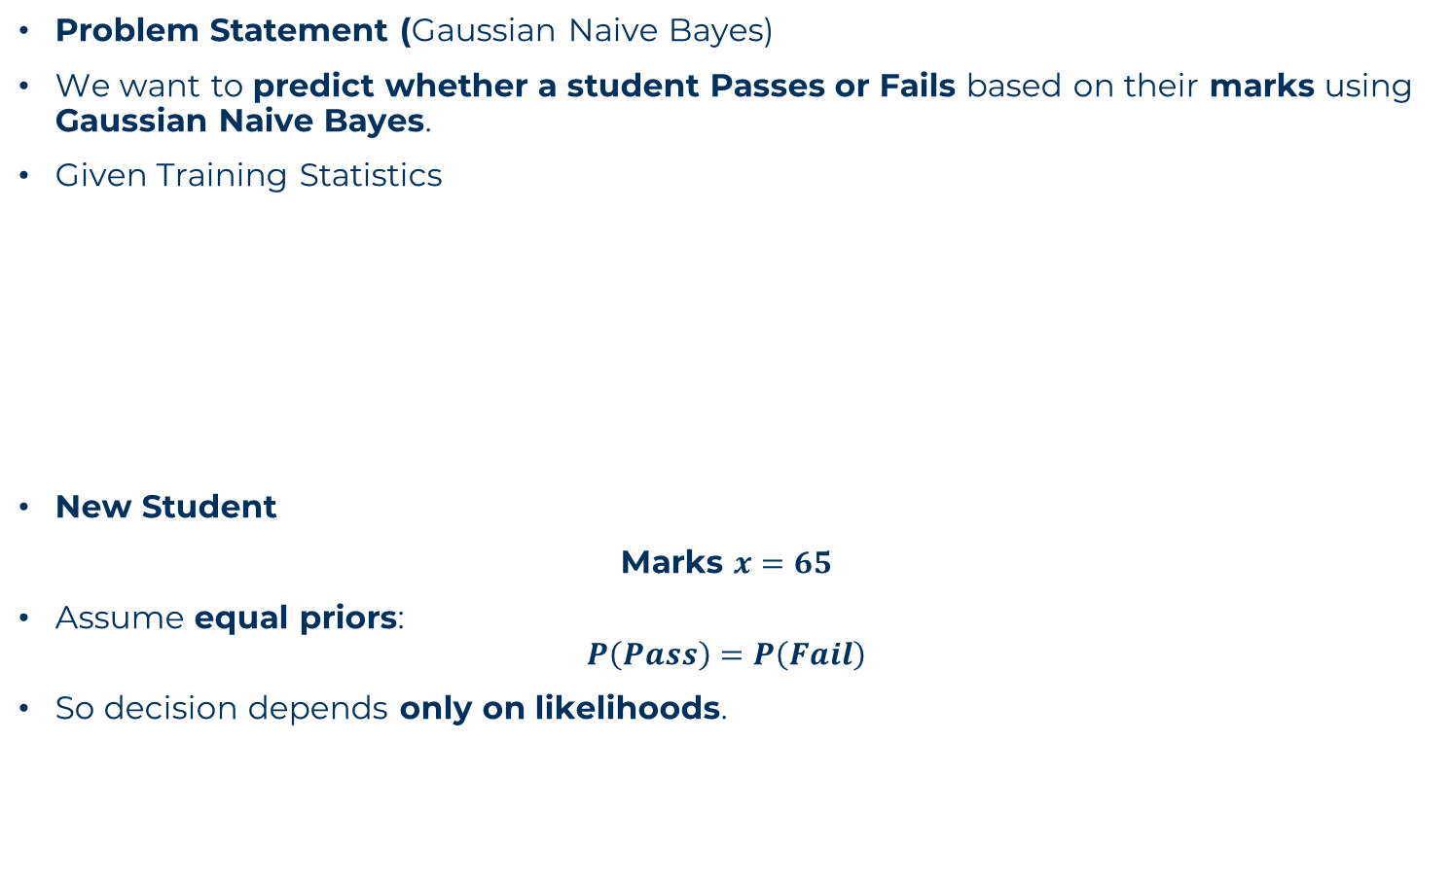
NAIVE BAYES CLASSIFIER
Problem Statement (Gaussian Naive Bayes)
We want to predict whether a student Passes or Fails based on their marks using Gaussian Naive Bayes.
Given Training Statistics
New Student
Marks $x=65$
Assume equal priors:
$$P\left(Pass\right)=P\left(Fail\right)$$
So decision depends only on likelihoods.
Class | Mean (μ) | Standard Deviation (σ)
Pass | 70 | 10
Fail | 40 | 8
Step 1: Gaussian Probability Density Function
Gaussian Naive Bayes assumes:
$$P\left(x∣C\right)=\frac{1}{\sqrt{2πσ^{2}}}\exp\left(−\frac{\left(x−μ{\left.)\right.}^{2}\right.}{2σ^{2}}\right)$$

Slide 14
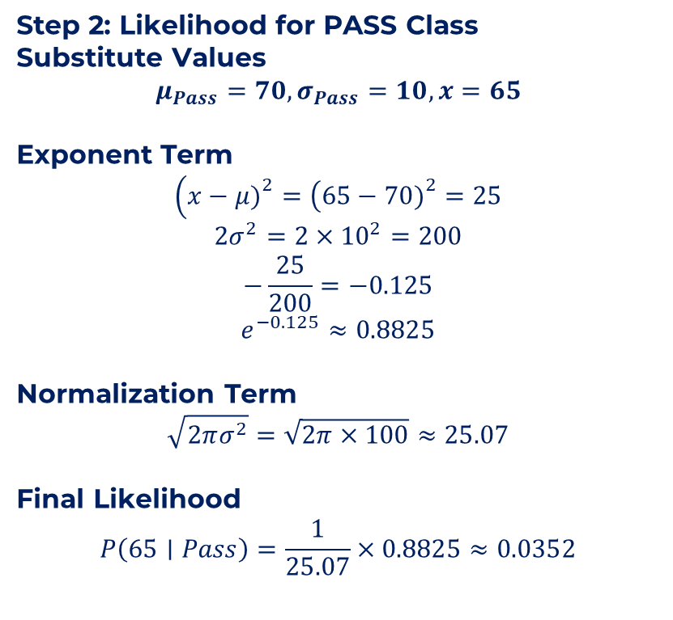
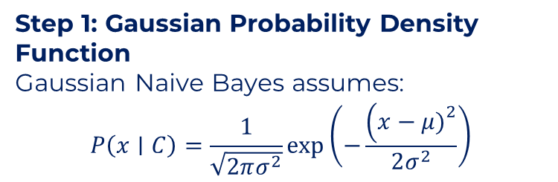
NAIVE BAYES CLASSIFIER
Problem Statement (Gaussian Naive Bayes)
We want to predict whether a student Passes or Fails based on their marks using Gaussian Naive Bayes.
Given Training Statistics
Step 2: Likelihood for PASS Class
Substitute Values
$$μ_{Pass}=70, σ_{Pass}=10, x=65$$
Exponent Term
$$\left(x−μ{\left.)\right.}^{2}=\left(65−70{\left.)\right.}^{2}=25\right.\right.$$
$$2σ^{2}=2×{10}^{2}=200$$
$$−\frac{25}{200}=−0.125$$
$$e^{−0.125}≈0.8825$$
Normalization Term
$$\sqrt{2πσ^{2}}=\sqrt{2π×100}≈25.07$$
Final Likelihood
$$P\left(65∣Pass\right)=\frac{1}{25.07}×0.8825≈0.0352$$
Class | Mean (μ) | Standard Deviation (σ)
Pass | 70 | 10
Fail | 40 | 8
Step 1: Gaussian Probability Density Function
Gaussian Naive Bayes assumes:
$$P\left(x∣C\right)=\frac{1}{\sqrt{2πσ^{2}}}\exp\left(−\frac{\left(x−μ{\left.)\right.}^{2}\right.}{2σ^{2}}\right)$$

Slide 15
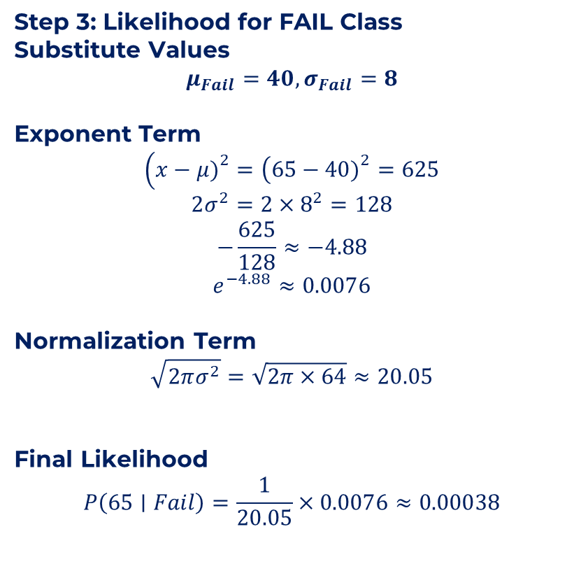
NAIVE BAYES CLASSIFIER
Problem Statement (Gaussian Naive Bayes)
We want to predict whether a student Passes or Fails based on their marks using Gaussian Naive Bayes.
Given Training Statistics
Step 3: Likelihood for FAIL Class
Substitute Values
$$μ_{Fail}=40, σ_{Fail}=8$$
Exponent Term
$$\left(x−μ{\left.)\right.}^{2}=\left(65−40{\left.)\right.}^{2}=625\right.\right.$$
$$2σ^{2}=2×8^{2}=128$$
$$−\frac{625}{128}≈−4.88$$
$$e^{−4.88}≈0.0076$$
Normalization Term
$$\sqrt{2πσ^{2}}=\sqrt{2π×64}≈20.05$$
Final Likelihood
$$P\left(65∣Fail\right)=\frac{1}{20.05}×0.0076≈0.00038$$
Class | Mean (μ) | Standard Deviation (σ)
Pass | 70 | 10
Fail | 40 | 8
Step 1: Gaussian Probability Density Function
Gaussian Naive Bayes assumes:
$$P\left(x∣C\right)=\frac{1}{\sqrt{2πσ^{2}}}\exp\left(−\frac{\left(x−μ{\left.)\right.}^{2}\right.}{2σ^{2}}\right)$$

Slide 16
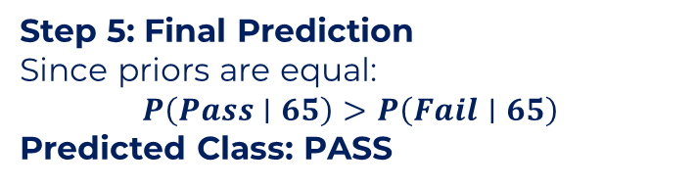
NAIVE BAYES CLASSIFIER
Problem Statement (Gaussian Naive Bayes)
We want to predict whether a student Passes or Fails based on their marks using Gaussian Naive Bayes.
Given Training Statistics
Step 5: Final Prediction
Since priors are equal:
$$P\left(Pass∣65\right)>P\left(Fail∣65\right)$$
Predicted Class: PASS
Class | Mean (μ) | Standard Deviation (σ)
Pass | 70 | 10
Fail | 40 | 8
Step 4: Compare Likelihoods
65 is close to the Pass mean (70)
65 is very far from the Fail mean (40)
Gaussian curve assigns:
High probability near the mean
Very low probability far from the mean
Class | Likelihood
Pass | 0.0352
Fail | 0.00038
P(65∣Pass)≫P(65∣Fail)

Slide 17
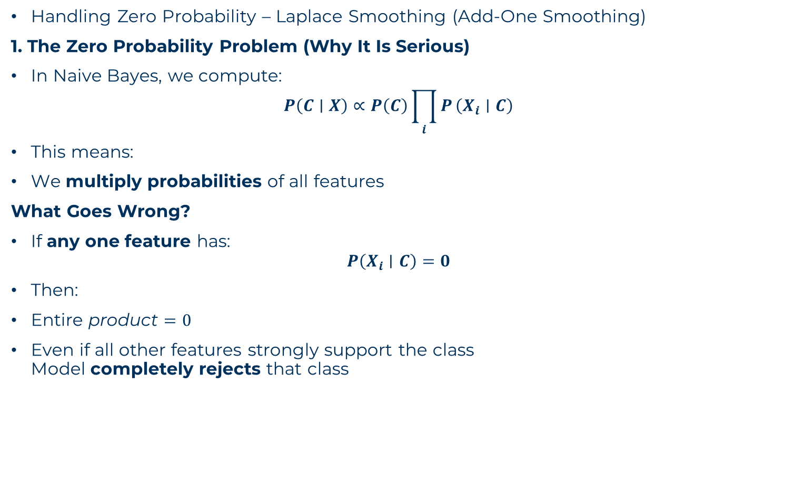
NAIVE BAYES CLASSIFIER
Handling Zero Probability – Laplace Smoothing (Add-One Smoothing)
1. The Zero Probability Problem (Why It Is Serious)
In Naive Bayes, we compute:
$$P\left(C∣X\right)∝P\left(C\right)\prod_{i}{P}\left(X_{i}∣C\right)$$
This means:
We multiply probabilities of all features
What Goes Wrong?
If any one feature has:
$$P\left(X_{i}∣C\right)=0$$
Then:
$\text{Entire} \text{product}=0$
Even if all other features strongly support the class Model completely rejects that class

Slide 18
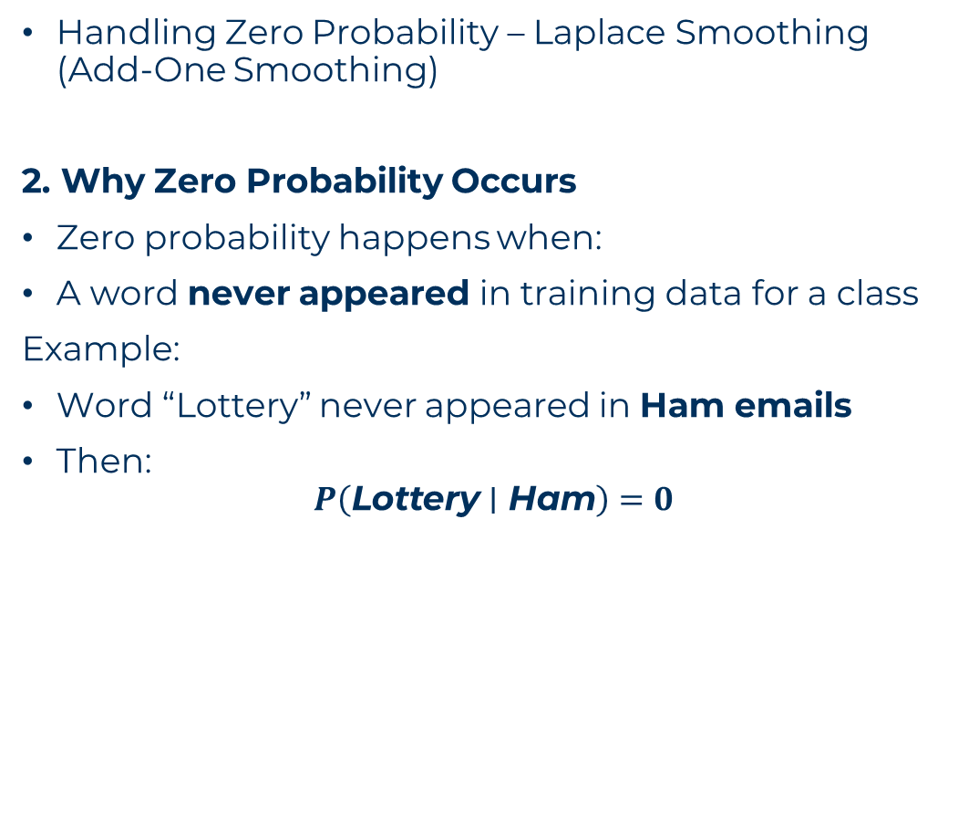
NAIVE BAYES CLASSIFIER
Handling Zero Probability – Laplace Smoothing (Add-One Smoothing)
2. Why Zero Probability Occurs
Zero probability happens when:
A word never appeared in training data for a class
Example:
Word “Lottery” never appeared in Ham emails
Then:
$$P\left(\text{Lottery}∣\text{Ham}\right)=0$$
Just because a word never appeared before, it does not mean it can never appear.
Training data is limited
Language evolves
Rare events exist
➡ Zero probability is too harsh and unrealistic

Slide 19

NAIVE BAYES CLASSIFIER
Handling Zero Probability – Laplace Smoothing (Add-One Smoothing)
4. Laplace Smoothing – The Solution
Laplace smoothing adds 1 to every count to avoid zeros.
Formula
$$P\left(\text{word}∣C\right)=\frac{\text{count}\text{(}\text{word}\text{, }\text{C}\text{)}+1}{\text{total} \text{words} \text{in} C+\text{vocabulary} \text{size}}$$

Slide 20
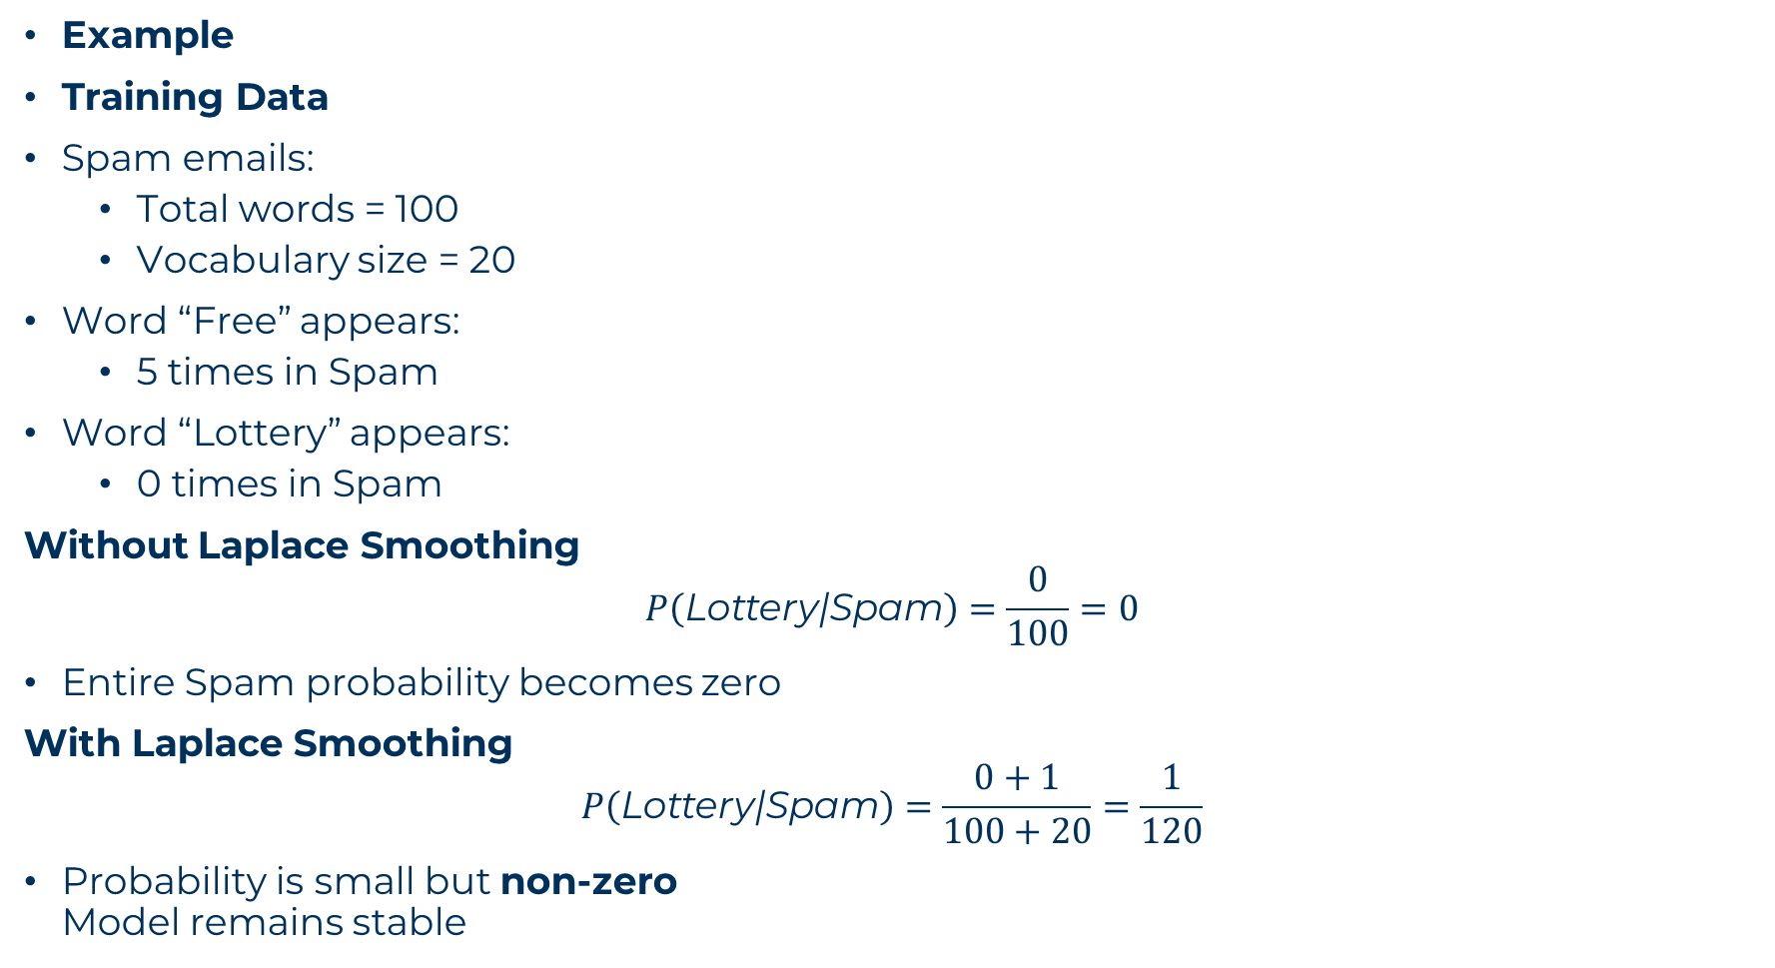
NAIVE BAYES CLASSIFIER
Example
Training Data
Spam emails:
Total words = 100
Vocabulary size = 20
Word “Free” appears:
5 times in Spam
Word “Lottery” appears:
0 times in Spam
Without Laplace Smoothing
$$P\left(\text{Lottery}\text{|}\text{Spam}\right)=\frac{0}{100}=0$$
Entire Spam probability becomes zero
With Laplace Smoothing
$$P\left(\text{Lottery}\text{|}\text{Spam}\right)=\frac{0+1}{100+20}=\frac{1}{120}$$
Probability is small but non-zero Model remains stable

